Slide 1




Already a subscriber? Log in
Have a print subscription? Activate now
Become a Subscriber!
You have read your 10 free articles for the month. Select a plan below to start your subscription today.
Digital Only Access
$9.99 a month
Plan details
Print + Digital Access
$19.99 a month
Plan details
Digital Only Trial
99¢ for 4 weeks*
Plan details
Terms and condition
Privacy policy
Powered by Syncronex©
Notes:
3 Plan Wall Template – note that our original thought was to make these ‘buttons’ which had a ‘hover’ effect of displaying the plan attributes/benefits, and a onclick effect of selecting the plan and putting you into the new start workflow…. However, I didn’t have time to figure out how to do that, so in my mock, I just cheated with an accordion that ended up ruining the responsive behavior.

Slide 2
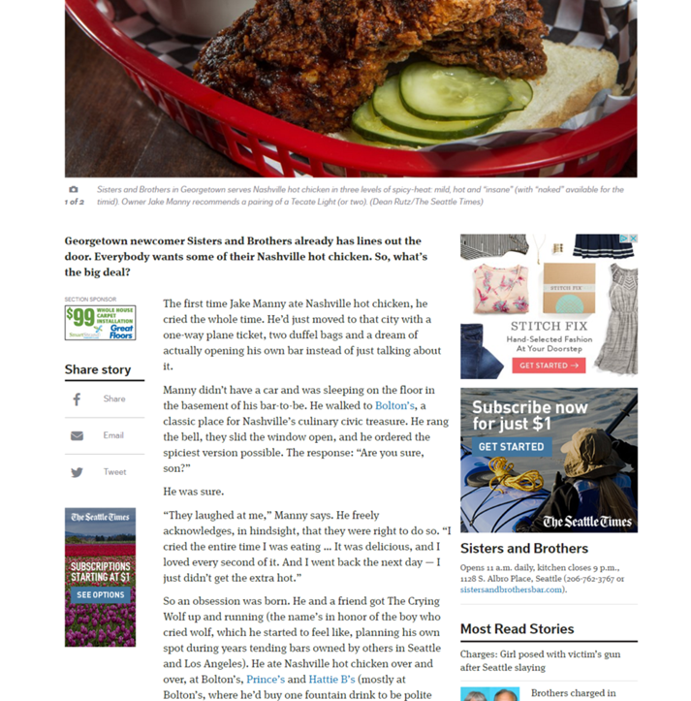
UNLIMTED ACCESS ONLY 99¢*
Subscribe or Log in
You have Read 9 out of 10 Free Articles.
*for the first 4 weeks then $9.99/mo
Powered by Syncronex©
Notes:
Just an example with a more traditional publisher color (blue seems to be the trend) – NOTE that Activation is not included, but we just didn’t design for it.. It COULD be on this alert, or it COULD be on the list of available plans page as an “If you already have a print subscription, Activate here” kind of thing.. Open to what makes sense.

Slide 3
Subscribe or Log in
You have Read 9 out of 10 Free Articles.
To continue reading without interruption
Email Address
Password
Notes:
This drop down for email and pwd should be the same color scheme as the original alert. I thought it would be cool to continue with the drop down theme that you had for the No plans draft you sent over. In this scenario, the anonymous user selected the Log-In button.

Slide 4
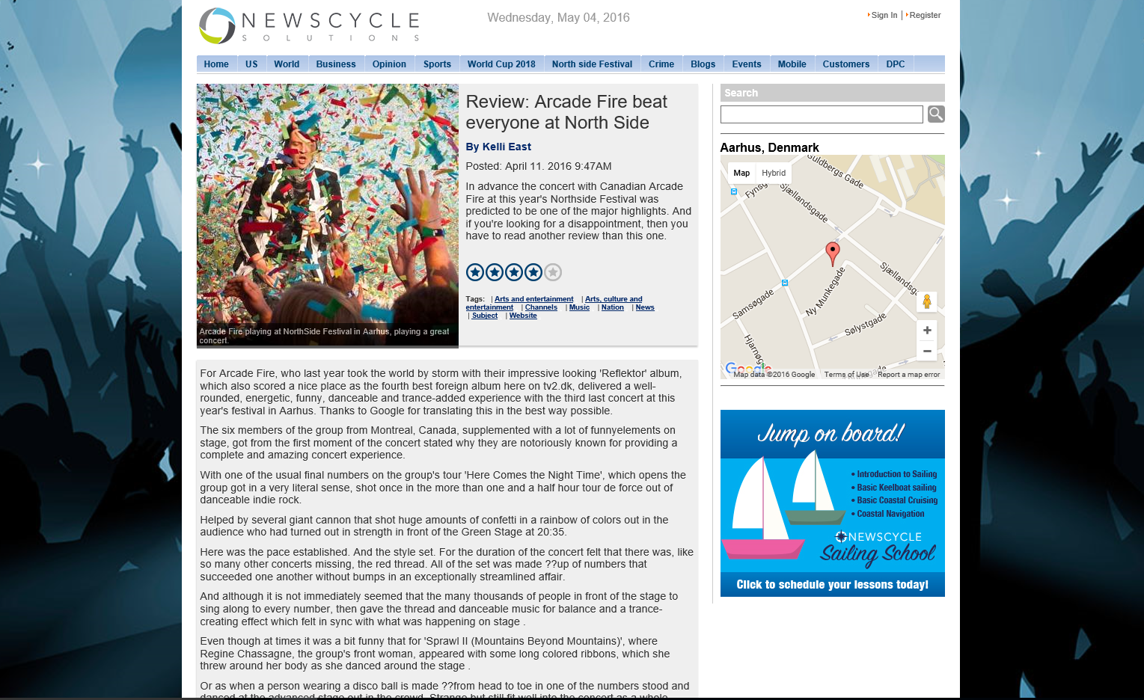

Digital
You have read 10 free articles this month.
To continue reading this article and more, subscribe now. Try it for only 99¢ for 4 weeks.
See my options
Log in
Print subscriber? Link your account
Powered by Syncronex©
Notes:
In-line paywall

Slide 5
Print subscriber? Link your account
Already a subscriber? Log in
Have a print subscription? Activate now
Thank you for reading!
We hope you enjoyed reading your free articles.
Click below to select a plan that’s perfect for you.
Benefits include:
Unlimited Access to www.acmenewsnow.com
Access to the E-edition
Access to iphone and Android Mobile Apps
Monthly and Yearly Subscription options. Cancel at anytime!
See my options
Terms of use I Privacy policy
Powered by Syncronex©
Notes:
No Plan Wall overlay

